Slide 1




DIGITAL LITERACY
SKILLS
ADVANCED USERS

Slide 2
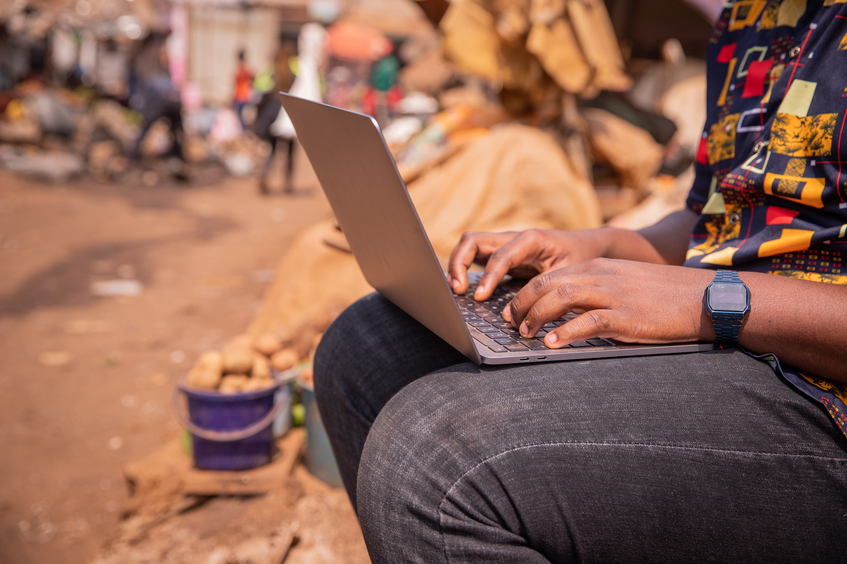
Module 3
Communication
and collaboration

Slide 3

7
Unit 7: Managing digital identity

Slide 4
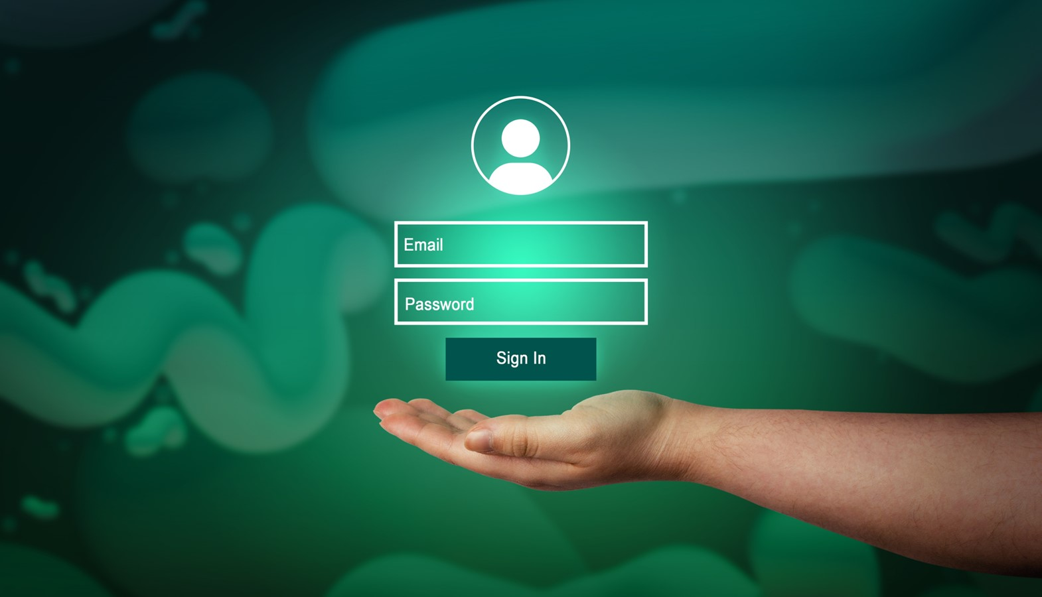
Definitions and protecting identity
The information we leave online about ourselves represents our digital identity. For example, when we use a username and password to authenticate ourselves on a website, we are using our digital identity.
Many services require us to log in from devices. E-commerce, banking, health services, tax services are just a few examples.
Our private data are taken and recorded, often without you even realising it. Therefore, you need to be aware and learn how to best manage your digital identity.

Slide 5

Definition of managing digital identity
Managing digital identity means:
“To create and manage one or multiple digital identities, to be able to protect one's own reputation, to deal with the data that one produces through different digital tools, environments and services”.

Slide 6

Identity theft
Cybercriminals hack and steal our personal or financial data.

Slide 7
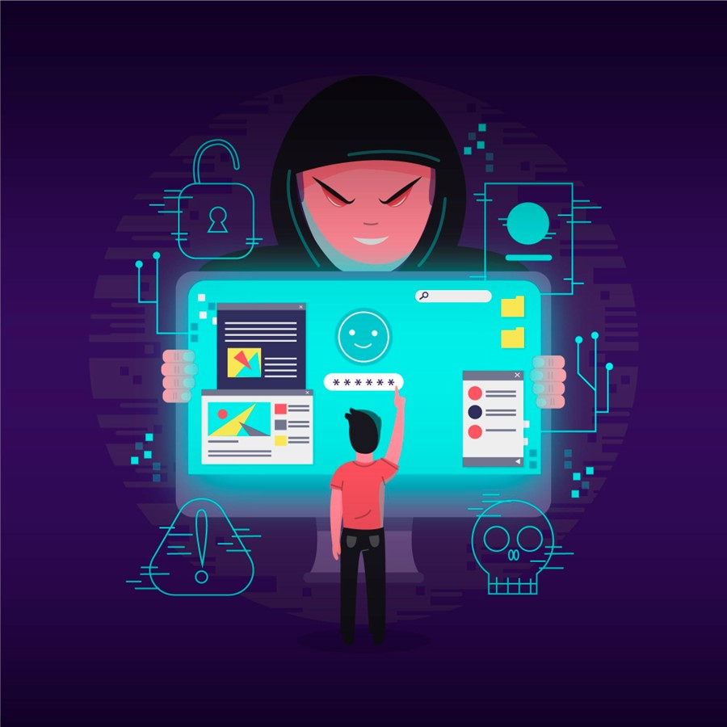
How to defend ourselves against cybercriminals
Be very careful when using the internet. Never open suspicious emails or messages. You need to be able to recognize whether the information you receive is true or not.
Ask:
Is it written correctly in your language?
Are there any strange signs?
Does it talk about operations of which you are not aware?

Slide 8

Ways to protect our digital identity
Use two-factor authentication
Change and diversify passwords
Avoid sharing sensitive information

Slide 9
Skills to practise
Discriminate multiple digital identities.
Make a list of all the apps for which you have login details.
Change login passwords that are the same.
Explain the more appropriate ways to protect one’s own reputation.
Create a list of behaviours that may harm you online reputation.
Next to each, list ways that will prevent this harm.
Change the data produced through several tools, environments, and services.
Open the social media apps that you have.
Delete any negative posts or comments that you have made.
Open your internet browser and clear the cache.

Slide 10
All back covers should include
contact information of the section
producing the work.
© United Nations Children’s Fund (UNICEF) [month and year of publication]

